Slide 1
Basic Network Concepts
- Layer 3 -

Slide 2
Agenda
Network Layer And Path Determination
IP Address Within The IP Header
IP Address Classes
Subnetting And Creating A Subnet
Layer 3 Devices And Network To Network Communication
ARP Concept
Routed And Routing Protocols
Classification Of Routing Protocol
Advanced Routing Concepts

Slide 3
Network Layer And Path Determination

Slide 4
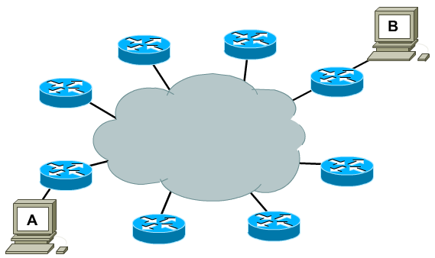
A network layer. Why?

Slide 5
Network layer
Segment network and control flow of traffic.
Move data through a set of networks.
Logical Addressing, use a hierarchical addressing scheme.

Slide 6
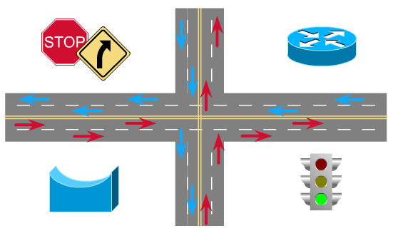
Network segmentation. Why?

Slide 7
Network segmentation
Control network traffics and reduce broadcast traffics.
Separate computer networks is managed by a single administration - Autonomous systems.

Slide 8
Router
Routers connect separate networks.
Routers make best path decisions based on Layer 3 information.
Routers actually switch packets from incoming ports to appropriate outgoing ports.

Slide 9
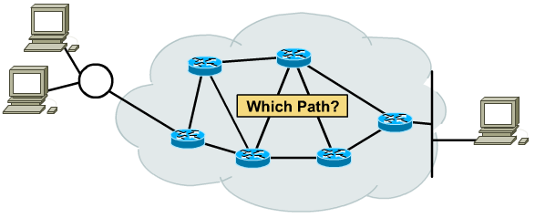
Path determination
Path determination is the process that the router uses to choose the next hop in the path for the packet to travel to its destination based on the link bandwidth, hop, delay ...

Slide 10
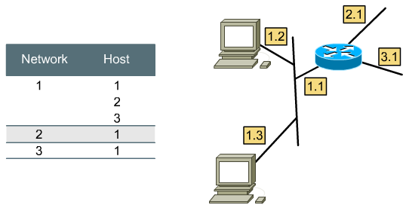
Network layer addressing
Network address + Host address: Hierarchical Addressing Schemes.

Slide 11

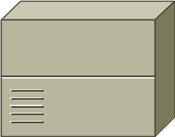
Flat Addressing Scheme
1
4
A
B
1 – A₁
2 – A₂
3 – A₃
1 – A
2 – A
3 – A
4 – B
5 – B
6 – B
2
5
6
3

Slide 12
Hierarchical Addressing Scheme
A1
B1
A
B
1 – A₁
2 – A₂
3 – A₃
A2
B2
A – Local
B – Switch to B
B3
A3

Slide 13
Hierarchical Addressing Scheme
International
Gateway
Domestic
Switch
Local
Switch
84 8 9321044

Slide 14
Network address
The network address helps the router identify a path within the network cloud.
The router uses the network address to identify the destination network of a packet within an internetwork.
Network address is assigned by higher-level administrator. Host address is assigned manually or automatically by manager of that network.

Slide 15
IP Address Within The IP Header

Slide 16
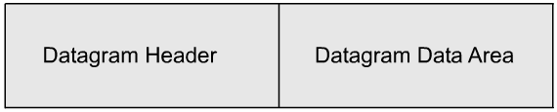
Network layer datagram
At the network layer, the data is encapsulated within packets (also known as datagrams).
Packet includes header - addressing and other control information - and actual data - whatever is passed down from the higher layers.

Slide 17
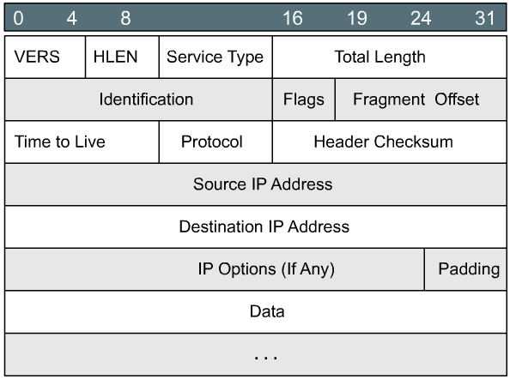
IP header format

Slide 18
IP header format: Version
4 bits.
Indicates the version of IP currently used.
  IPv4 : 0100
  IPv6 : 0110

Slide 19
IP header format: Header length
4 bits.
IP header length : Indicates the datagram header length in 32 bit words (4 bits), and thus points to the beginning of the data.

Slide 20
IP header format: Service type
8 bits.
Specifies the level of importance that has been assigned by a particular upper-layer protocol.
  Precedence.
  Reliability.
  Speed.

Slide 21
IP header format: Total length
16 bits.
Specifies the length of the entire IP packet, including data and header, in bytes.

Slide 22
IP header format: Identification
16 bits.
Identification contains an integer that identifies the current datagram.
Assigned by the sender to aid in assembling the fragments of a datagram.

Slide 23
IP header format: Flags
3 bits.
The second bit specifying whether the packet can be fragmented .
The last bit specifying whether the packet is the last fragment in a series of fragmented packets.

Slide 24
IP header format: Time to Live
8 bits.
Time-to-Live maintains a counter that gradually decreases to zero, at which point the datagram is discarded, keeping the packets from looping endlessly.

Slide 25
IP header format: Protocol
8 bits.
Indicates which upper-layer protocol receives incoming packets after IP processing has been completed
  06 : TCP
  17 : UDP

Slide 26
IP header format: Header checksum
16 bits.
A checksum on the header only, helps ensure IP header integrity.

Slide 27
IP header format: Addresses
32 bits each.
Source IP Address
Destination IP Address

Slide 28
IP header format: Options
Variable length.
Allows IP to support various options, such as security, route, error report ...

Slide 29
IP header format: Padding
The header padding is used to ensure that the internet header ends on a 32 bit boundary.

Slide 30
IP Address Classes

Slide 31
IP network address
Network layer addresses are 32 bits long.
The are presented as four octets in dotted decimal format.
The IP address has two components: Network ID and Host ID.

Slide 32

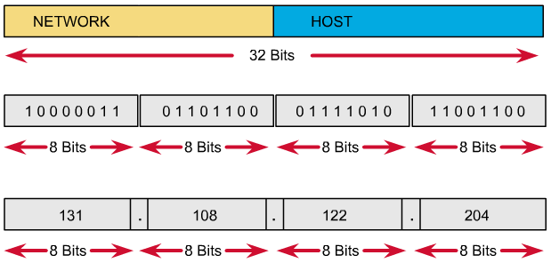
IP address format

Slide 33
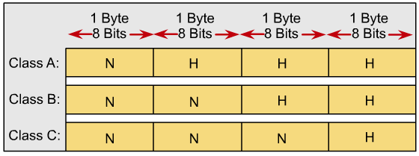
IP address classes
Different class addresses reserve different amounts of bits for the Network and Host portions of the address
Provide the flexibility required to support different size networks

Slide 34
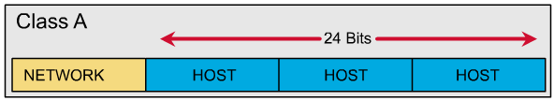
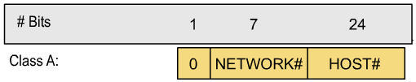
IP address classes: Class A

Slide 35
IP address classes: Class A
The first bit of a Class A address is always 0.
The first 8 bits to identify the network part of the address.
Possible network address from 1.0.0.0 to 127.0.0.0.
The remaining three octets can be used for the host portion of the address.
Each class A network have up to 16,777,214 possible IP addresses.

Slide 36
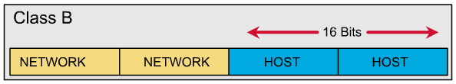

IP address classes: Class B

Slide 37
IP address classes: Class B
The first 2 bits of a Class B address is always 10.
The first two octets to identify the network part of the address.
Possible network address from 128.0.0.0 to 191.255.0.0.
The remaining two octets can be used for the host portion of the address.
Class B network have up to 65.534 possible IP addresses.

Slide 38
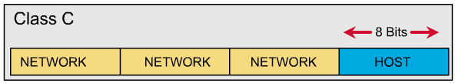
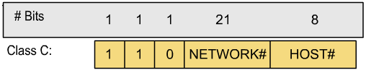
IP address classes: Class C

Slide 39
IP address classes: Class C
The first 3 bits of a Class C address is always 110.
The first three octets to identify the network part of the address.
Possible network address from 192.0.0.0 to 223.255.255.0.
The remaining last octet can be used for the host portion of the address.
Class C network have up to 254 possible IP addresses.

Slide 40
IP address classes: Summary
1.0.0.0 - 126.0.0.0 : Class A.
127.0.0.0 : Loopback network.
128.0.0.0 - 191.255.0.0 : Class B.
192.0.0.0 - 223.255.255.0 : Class C.
224.0.0.0 < 240.0.0.0 : Class D, multicast.
>= 240.0.0.0 : Class E, reserved.

Slide 41
Network address
Network address provide a convenient way to refer to all of the addresses on a particular network or subnetwork.
Two hosts with differing network address require a device, typically a router, in order to communicate.
An IP address that ends with binary 0s in all host bits is reserved for the network address.

Slide 42
Broadcast address
Broadcast goes to every host with a particular network ID number.
An IP address that ends with binary 1s in all host bits is reserved for the directed broadcast address.
An IP address with binary 1s in all network bits and host bits is reserved for the local broadcast address.

Slide 43
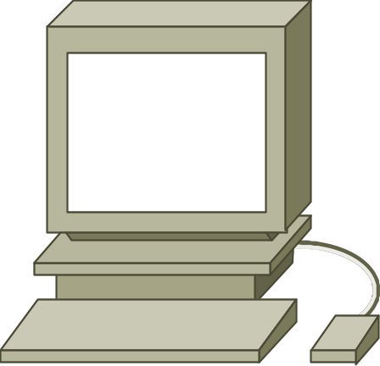

Local broadcast address
STOP
255.255.255.255

Slide 44
Directed broadcast address
192.168.20.0
192.168.20.255
Broadcast address

Slide 45
Example: 172.16.20.200
172.16.20.200 is Class B address
Network portion: 172.16
Host portion: 20.200
Network address: 172.16.0.0
Broadcast address: 172.16.255.255

Slide 46
Private addresses
According to RFC-1918.
Organizations make use of the private Internet address space for hosts that require IP connectivity within their enterprise network, but do not require external connections to the global Internet.
Class A: 10.0.0.0.
Class B: 172.16.0.0 - 172.31.0.0.
Class C: 192.168.0.0 - 192.168.255.0.

Slide 47
Subnetting And Creating A Subnet

Slide 48
Why we need to divide network?
Network administrators sometimes need to divide networks, especially large ones, into smaller networks:
  Reduce the size of a broadcast domain.
  Improve network security.
  Implement the hierarchical managements.
So we need more network addresses for your network. But I want the outside networks see our network as a single network.

Slide 49
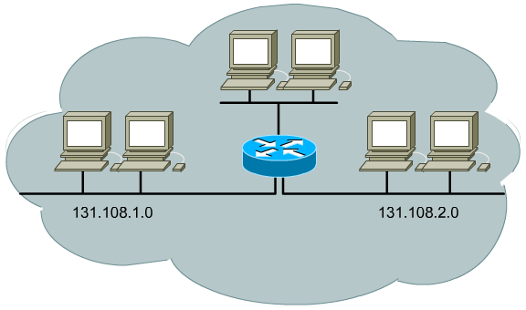
Divide network by three

Slide 50
Subnetting
Subnetworks are smaller divisions of network.
Subnet addresses include the Class A, Class B, or Class C network portion, plus a subnet field and a host field.
To create a subnet address, a network administrator borrows bits from the original host portion and designates them as the subnet field.
Subnet addresses are assigned locally, usually by a network administrator.

Slide 51
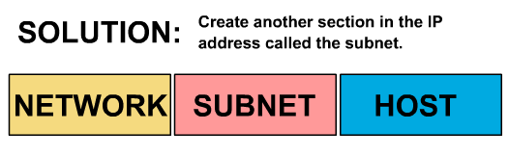
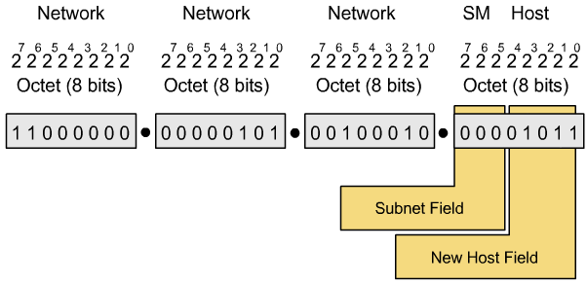
Subnetting

Slide 52
Subnet mask
“Extended Network Prefix”.
Determines which part of an IP address is the network field and which part is the host field.
32 bits long.
Divided into four octets.
Network and Subnet portions all 1’s.
Host portions all 0’s.

Slide 53
Default subnet mask: Example
192.168.2.100 / 255.255.255.0.
11000000.10101000.00000010.01100100.
11111111.11111111.11111111.00000000.
11000000.10101000.00000010.01100100.
Class C network:
  24 bits for network portion.
  0 bits for subnet portion.
  8 bits for host portion.
Subnet address: 192.168.2.0.

Slide 54
Subnet mask: Example
172.16.65.100 / 255.255.240.0.
10101100.00010000.01000001.01100100.
11111111.11111111.11110000.00000000.
10101100.00010000.01000001.01100100.
Class B network:
  16 bits for network portion.
  4 bits for subnet portion.
  12 bits for host portion.
Subnet address: 172.16.64.0.

Slide 55
How many bits can I borrow?
All of subnet bits are:
  0 : reserved for network address.
  1 : reserved for broadcast address.
The minimum bits you can borrow is:
  2 bits.
The maximum bits you can borrow is:
  A: 22 bits ~ 2²² - 2 = 4.194.302 subnets.
  B: 14 bits ~ 2¹⁴ - 2 = 16.382 subnets.
  C: 06 bits ~ 2⁰⁶ - 2 = 62 subnets.

Slide 56
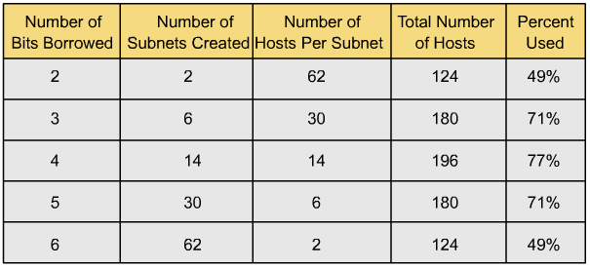
Addresses are loose by subnetting
Network administrator must strike a balance between the number of subnets required, the hosts per subnet that is acceptable, and the resulting waste of addresses.

Slide 57
Exercises with IP Address
With a given IP Address/Mask pair, answer the following questions:
  Does it belong to a subnet? If it does, how many subnet are there in the “big” network?
  How many host are there in that subnet?
  What is the network address?
  What is the broadcast address?
  What are the list of valid addresses stay in the same subnet?

Slide 58
Exercises with IP Address
Answer for the above questions:
  2^{n} (– 2) subnets
  2^{(host_bit – n)} – 2 hosts
  Rule with “unpleasant number”
  Rule with “unpleasant number”
  Addresses in the range from network address to broadcast address

Slide 59
Exercises with IP Address
172.16.32.100/255.255.248.0
  It is a class B address → mask must be 255.255.0.0 → .248. is “subnet” part → n = 5 → There are 2⁵ = 32 subnets
  Host_bit = 16 → There are 2⁽¹⁶⁻⁵⁾ – 2 = 2¹¹ – 2 = 2046 hosts
  Network address is 172.16.32.0
  Broadcast address is 172.16.39.255
  Valid addresses: 172.16.32.1 → 172.168.39.254

Slide 60
Layer 3 Devices And Network To Network Communication

Slide 61
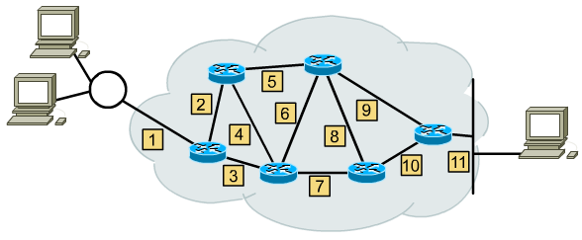
Internetworking

Slide 62
Path determination
Path determination is the process that the router uses to choose the next hop in the path for the packet to travel to its destination based on the link bandwidth, hop, delay ...

Slide 63
Router
A router is a type of internetworking device that passes data packets between networks, based on Layer 3 addresses.
A router has the ability to make intelligent decisions regarding the best path for delivery of data on the network.

Slide 64
IP addresses
IP addresses are implemented in software, and refer to the network on which a device is located.
IP addressing scheme, according to their geographical location, department, or floor within a building.
Because they are implemented in software, IP addresses are fairly easy to change.

Slide 65
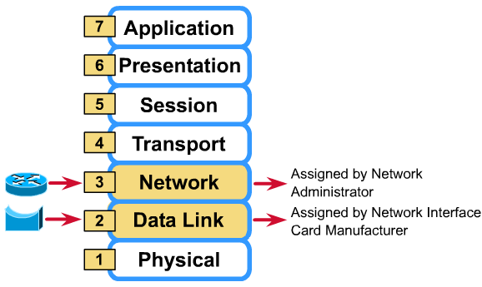
Router and Bridge

Slide 66
Router connections
Routers connect two or more networks, each of which must have a unique network number in order for routing to be successful.
The unique network number is incorporated into the IP address that is assigned to each device attached to that network.

Slide 67
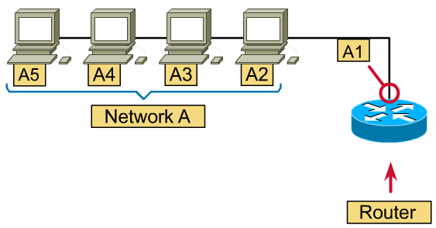
Router Interface

Slide 68
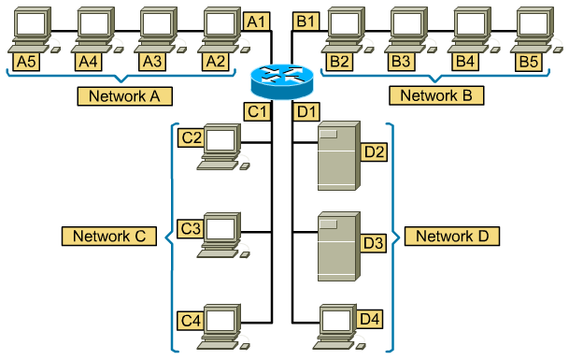
Router function

Slide 69
Router function
Strips off the data link header, carried by the frame.
(The data link header contains the MAC addresses of the source and destination.)

Slide 70
Router function
Examines the network layer address to determine the destination network.

Slide 71
Router function
Consults its routing tables to determine which of its interfaces it will use to send the data, in order for it to reach its destination network.

Slide 72
Router function
Send the data out interface B1, the router would encapsulate the data in the appropriate data link frame.

Slide 73
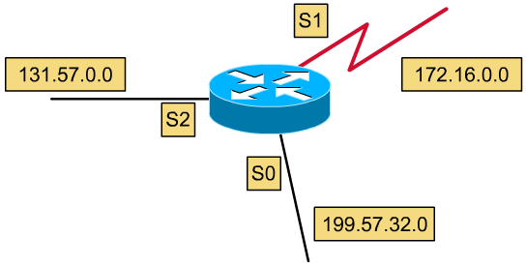
Router Interface example
Interface is a router’s attachment to a network, it may also be referred to as a port. In IP routing.
Each interface must have a separate, unique network address.

Slide 74
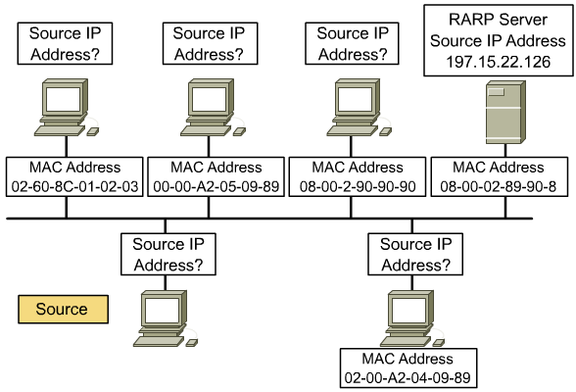
IP address assignment
static addressing and dynamic addressing

Slide 75
Static addressing
You must go to each individual device and configure it with an IP address.
You should keep very meticulous records, because problems can occur on the network if you use duplicate IP addresses.

Slide 76
Dynamic addressing
There are a few different methods that you can use to assign IP addresses dynamically:
  RARP: Reverse Address Resolution Protocol.
  BOOTP: BOOTstrap Protocol.
  DHCP: Dynamic Host Configuration Protocol.

Slide 77
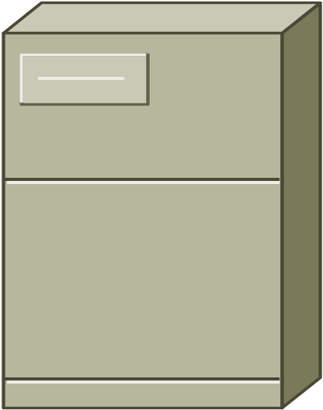
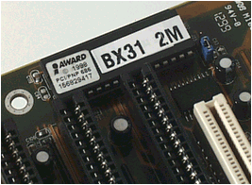
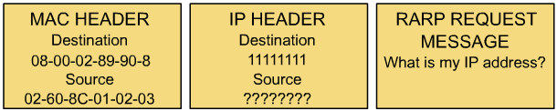
Dynamic addressing: RARP
RARP Request
RARP Reply
MAC: Known
IP: Unknown
RARP server

Slide 78
Dynamic addressing: BOOTP
UDP Broadcast
UDP Broadcast
MAC: Known
IP: Unknown
BOOTP server
IP Address
IP of server
Vendor-specific
MAC1 – IP1
MAC2 – IP2
MAC3 – IP3

Slide 79
Dynamic addressing: DHCP
DHCP Discover
UDP Broadcast
DHCP Offer
UDP Broadcast
DHCP Request
DHCP Ack
DHCP server
MAC: Known
IP: Unknown
IP Address
Gateway
IP of servers
And more …
IP1
IP2
IP3

Slide 80
ARP Concept

Slide 81
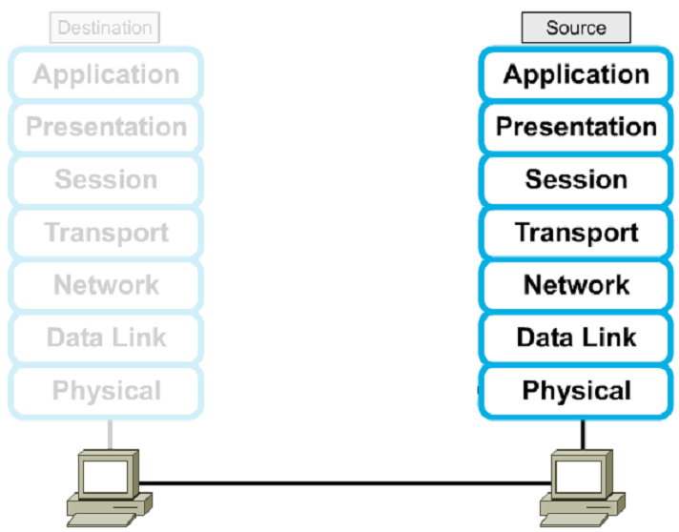




Encapsulation

Slide 82
Address resolution protocol
In order for devices to communicate, the sending devices need both the IP addresses and the MAC addresses of the destination devices.
When they try to communicate with devices whose IP addresses they know, they must determine the MAC addresses.
ARP enables a computer to find the MAC address of the computer that is associated with an IP address.

Slide 83
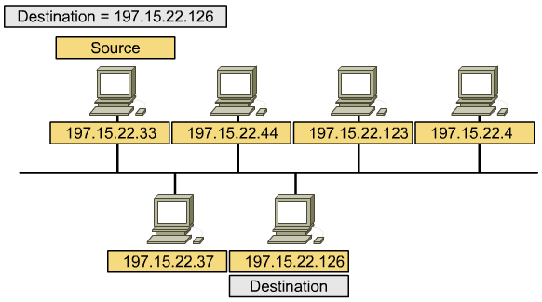
Address resolution protocol

Slide 84
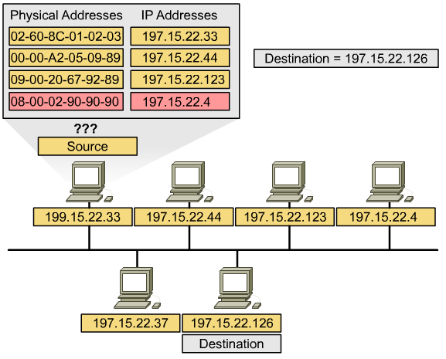
ARP table in host
RAM

Slide 85

ARP operation
ARP Table:
?
MAC
A.B.C.1.2.3
MAC
?
IP
10.0.2.1
IP
10.0.2.9
Data
10.0.2.1
10.0.2.5
10.0.2.9
A.B.C.1.2.3
A.B.C.4.5.6
A.B.C.7.8.9
A
B
C

Slide 86
ARP operation: ARP request
MAC
A.B.C.1.2.3
MAC
ff.ff.ff.ff.ff.ff
IP
10.0.2.1
IP
10.0.2.9
What is your MAC Addr?
10.0.2.1
10.0.2.5
10.0.2.9
A.B.C.1.2.3
A.B.C.4.5.6
A.B.C.7.8.9
A
B
C

Slide 87
ARP operation: Checking
MAC
A.B.C.1.2.3
MAC
ff.ff.ff.ff.ff.ff
IP
10.0.2.1
IP
10.0.2.9
What is your MAC Addr?
That is
my IP
10.0.2.1
10.0.2.5
10.0.2.9
A.B.C.1.2.3
A.B.C.4.5.6
A.B.C.7.8.9
A
B
C

Slide 88
ARP operation: ARP reply
MAC
A.B.C.7.8.9
MAC
A.B.C.1.2.3
IP
10.0.2.9
IP
10.0.2.1
This is my MAC Addr
10.0.2.1
10.0.2.5
10.0.2.9
A.B.C.1.2.3
A.B.C.4.5.6
A.B.C.7.8.9
A
B
C

Slide 89
ARP operation: Caching
ARP Table:
A.B.C.7.8.9 – 10.0.2.9
MAC
A.B.C.1.2.3
MAC
A.B.C.7.8.9
IP
10.0.2.1
IP
10.0.2.9
Data
10.0.2.1
10.0.2.5
10.0.2.9
A.B.C.1.2.3
A.B.C.4.5.6
A.B.C.7.8.9
A
B
C

Slide 90
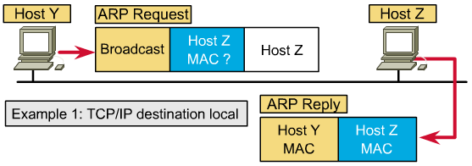
ARP: Destination local

Slide 91
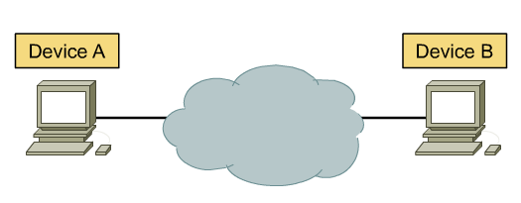
Internetwork communication
How to communicate with devices that are not on the same physical network segment.

Slide 92
Default gateway
In order for a device to communicate with another device on another network, you must supply it with a default gateway.
A default gateway is the IP address of the interface on the router that connects to the network segment on which the source host is located.
In order for a device to send data to the address of a device that is on another network segment, the source device sends the data to a default gateway.

Slide 93
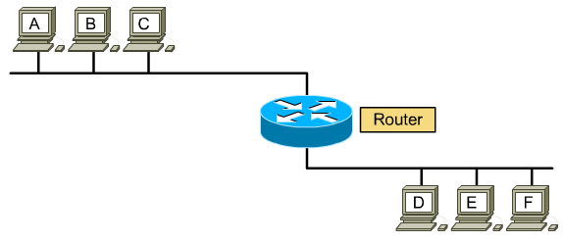
Proxy ARP
Proxy ARP is a variation of the ARP.
In the case the source host does not have a default gateway configured.

Slide 94
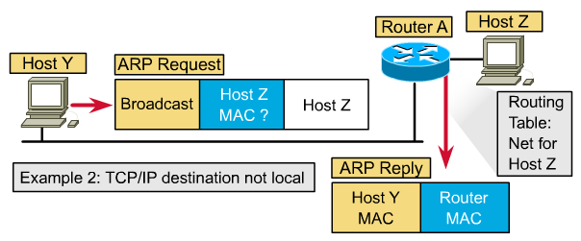
ARP: Destination not local

Slide 95
ARP Flowchart
Send Data
to a device
Is the
MAC address
in my ARP
cache
N
Send an
ARP request
Y
Get an
ARP reply
Send Data

Slide 96
Routed And Routing Protocols

Slide 97
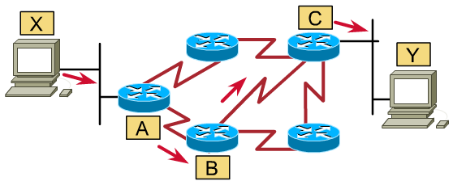
Network protocols
In order to allow two host communicate together through internetwork, they need a same network protocol.
Protocols are like languages.
IP is a network layer protocol.

Slide 98
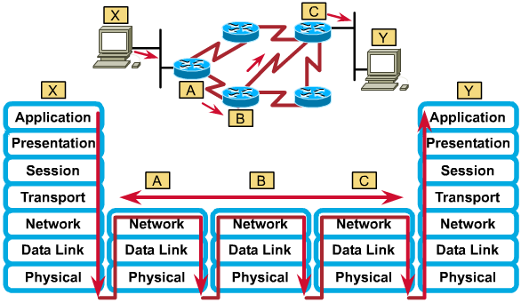
Network protocol operation

Slide 99
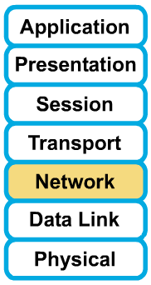
Routed protocol
Protocols that provide support for the network layer are called routed or routable protocols.
IP is a network layer protocol, and because of that, it can be routed over an internetwork.

Slide 100
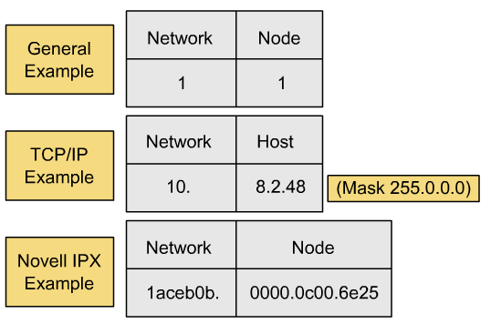
Protocol addressing variations

Slide 101
Three important routed protocols
TCP/IP: 04 bytes
  Class A: 1 byte network + 3 bytes host
  Class B: 2 bytes network + 2 bytes host
  Class C: 3 bytes network + 1 byte host
IPX/SPX: 10 bytes
  4 bytes network + 6 bytes host
AppleTalk: 03 bytes
  2 bytes network + 1 byte host

Slide 102
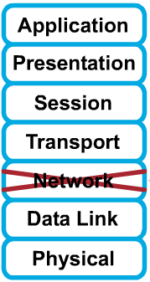
Non-routable protocol
Non-routable protocols are protocols that do not support Layer 3.
The most common of these non-routable protocols is NetBEUI.
NetBEUI is a small, fast, and efficient protocol that is limited to running on one segment.

Slide 103
Classification Of Routing Protocol

Slide 104
Classification #1: Static and Dynamic
Static routes:
  The network administrator manually enter the routing information in the router.
Dynamic routes:
  Routers can learn the information from each other on the fly.
  Using routing protocol to update routing information.
  RIP, IGRP, EIGRP, OSPF …

Slide 105
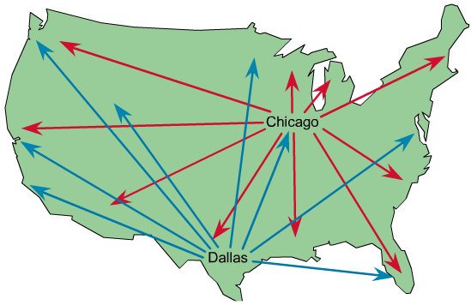
Static routes

Slide 106
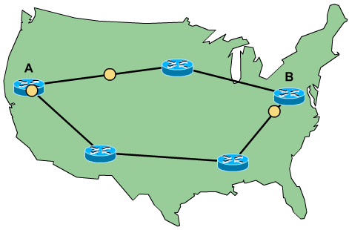
Dynamic routes

Slide 107
Static vs. dynamic routes
Static routes:
  For hiding parts of an internetwork.
  To test a particular link in a network.
  For maintaining routing tables whenever there is only one path to a destination network.
Dynamic routes:
  Maintenance of routing table.
  Timely distribution of information in the form of routing updates.
  Relies on routing protocol to share knowledge.
  Routers can adjust to changing network conditions.

Slide 108
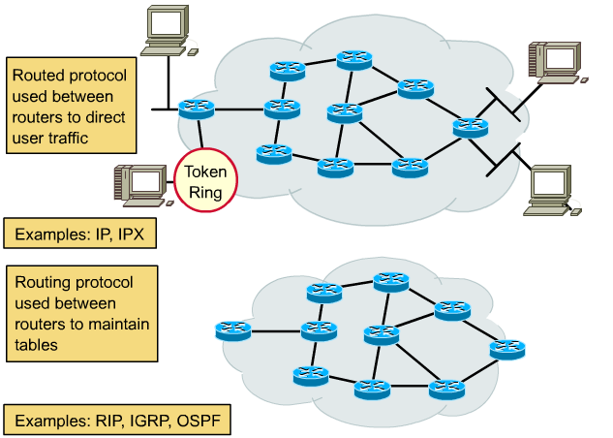
Classification #2: Routed vs. Routing protocol
Routing protocols
determine how routed
protocols are routed

Slide 109
Classification #3: IGP and EGP
Dynamic routes.
Interior Gateway Protocols (RIP, IGRP, EIGRP, OSPF):
  Be used within an autonomous system, a network of routers under one administration, like a corporate network, a school district's network, or a government agency's network.
Exterior Gateway Protocols (EGP, BGP):
  Be used to route packets between autonomous systems.

Slide 110
Classification #4: DVP and LSP
Distance-Vector Protocols (RIP, IGRP):
  View network topology from neighbor’s perspective.
  Add distance vectors from router to router.
  Frequent, periodic updates.
  Pass copy of routing tables to neighbor routers.
Link State Protocols (OSPF):
  Gets common view of entire network topology.
  Calculates the shortest path to other routers.
  Event-triggered updates.
  Passes link state routing updates to other routers.

Slide 111
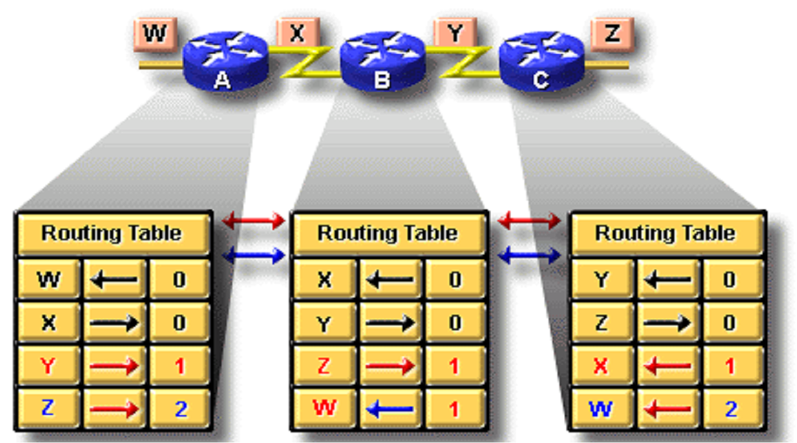
Distance vector routing

Slide 112
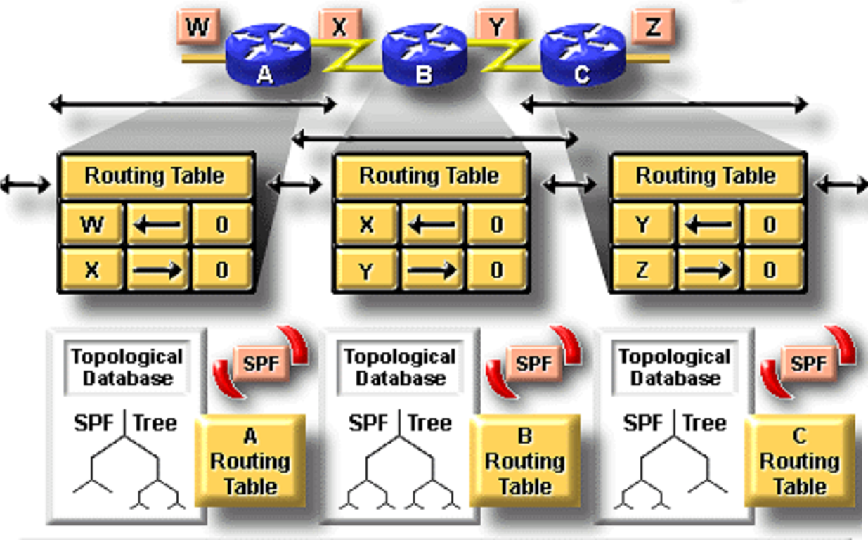
Link state routing

Slide 113
RIP
Most popular.
Interior Gateway Protocol.
Distance Vector Protocol.
Only metric is number of hops.
Maximum number of hops is 15.
Updates every 30 seconds.
Doesn’t always select fastest path.
Generates lots of network traffic.

Slide 114
OSPF
Open Shortest Path First.
Interior Gateway Protocol.
Link State Protocol.
Metric is compose of cost, speed, traffic, reliability, and security.
Event-triggered updates.

Slide 115
ICMP Concept

Slide 116
ICMP
Internet Control Message Protocol (RFC 792) helps to manage and control the operation of a TCP/IP network.
ICMP uses messages to accomplish its tasks.
  Destination Unreachable
  Time Exceeded
  Redirect
  Echo

Slide 117
Destination Unreachable ICMP Message
The message is sent when a packet cannot be delivered completely to the application at the destination host.
Unreachable Code | Who send it?
Network unreachable | Router
Host unreachable | Router
Can’t fragment | Router
Protocol unreachable | Endpoint Host
Port unreachable | Endpoint Host

Slide 118
Time Exceeded ICMP Message
Notify a host when a packet it sent has been discarded because it was “out of time.”
Routers decrement TTL in IP header of each packet by 1 every time they forward a packet
If a router decrements TTL to 0, it throws away the packet.
The trace/tracert command utilize this behavior to work.

Slide 119
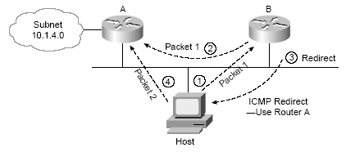
Redirect ICMP Message

Slide 120
Advanced Routing Concepts

Slide 121
VLSM
Variable-Length Subnet Mask
Occur when more than one mask is used in a single Class A, B, or C network.
Reduce the number of wasted IP addresses in each subnet, allow for more subnets, and avoid having to obtain another registered IP network number from the NIC.
A routing protocol must advertise not only the subnet number, but also the subnet mask, when advertising routes to support VLSM.

Slide 122
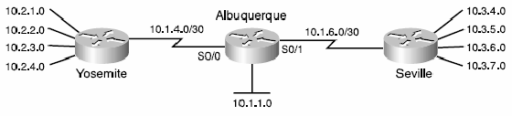
VLSM
Mask: 255.255.255.0 except where shown

Slide 123
CIDR
Classless InterDomain Routing is a convention defined in RFC 1817 that calls for aggregating multiple network numbers into a single routing entity.
Help the scalability of Internet routers by reducing the number of entries in the routing table
CIDR also helps prevent the wasting of IP addresses, thereby reducing the need for registered IP network numbers.

Slide 124
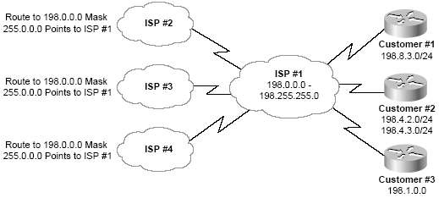
CIDR
Typical use of CIDR

Slide 125
Thank you !

